Slide 1
Not Pigou:
Externalities and civil society in the supply-demand framework
October 2023

Slide 2
Externality?
“Externalities refers to situations when the effect of production or consumption of goods and services imposes costs or benefits on others which are not reflected in the prices charged for the goods and services being provided.”
  Quote from OECD
Image credit: clipart.email

Slide 3
Externality?
“Externalities refers to situations when the effect of production or consumption of goods and services imposes costs or benefits on others which are not reflected in the prices charged for the goods and services being provided.”
  Quote from OECD
  Prices are the fundamental concept for understanding externalities and
  why public policy has sometimes made externalities worse.
  Pecuniary externality

Slide 4
Outline
The Pigouvian “solution”
  Highly redistributive
  Expect attempts to undermine it
Voluntary self-regulation
  Coase bargaining
  Cooperation costs, with Coase bargaining as a limiting case
Cooperation and group size
Examples
  Families, buyers’ clubs, insurance groups, healthcare in the workplace

Slide 5

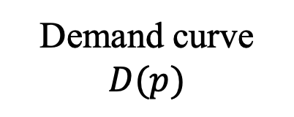
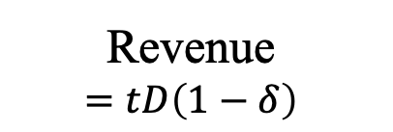



Figure 1. A Negative Production Externality
Price
Demand curve $D(p)$
Marginal social cost
$$1+t=1−δ$$
Net social benefit
Revenue
$$=tD\left(1−δ\right)$$
Transfer from consumers to harmed parties
U
Marginal private cost
$$1$$
Quantity
0
$$q_{e}=D(1−δ)$$
$$q_{u}=D(1)$$

Slide 6
Conclusions about Pigouvian taxes
Efficiency is not the same as zero externality
The magnitudes of redistribution and net benefit
  Net benefit comes from production change
  Redistribution comes from the production level
  i.e., much more redistribution than net benefit
Expect polaration rather than cooperation from Pigou

Slide 7
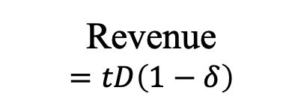
Figure 1. A Negative Production Externality
Price
Demand curve $D(p)$
Marginal social cost
$$1+t=1−δ$$
Net social benefit
Revenue
$$=tD\left(1−δ\right)$$
Transfer from consumers to harmed parties
U
Marginal private cost
$$1$$
Quantity
0
$$q_{e}=D(1−δ)$$
$$q_{u}=D(1)$$

Slide 8
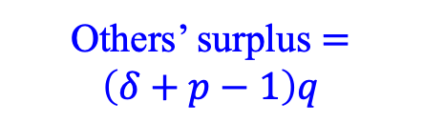

Figure 2. Pareto Improving Externality Management
(negative externality, without cooperation costs)
Price
Demand curve $D(p)$
Marginal social cost
E₁
$$1−δ$$
Consumer indifference
Others’ surplus $=\left(δ+p−1\right)q$
Marginal private cost
U
Iso-others
$$1$$
E₂
Consumer indifference
E₃
Quantity
0
$$q_{e}=D(1−δ)$$
$$q_{u}=D(1)$$

Slide 9
Conclusions about Pigouvian taxes
Efficiency is not the same as zero externality
The scales of redistribution and net benefit
  Net benefit comes from production change
  Redistribution comes from the production level
  i.e., much more redistribution than net benefit
Expect polaration rather than cooperation from Pigou
Pareto improving allocations: off the demand curve
  lower average prices (less than 1)
  greater marginal prices (greater than 1)

Slide 10
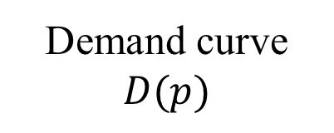
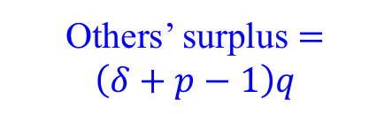


Nudge: moving q a little bit off the demand curve is easy
Price
Demand curve $D(p)$
Others’ surplus $=\left(δ+p−1\right)q$
Marginal private cost
U
$$1$$
Consumer indifference
Quantity
0
$$q_{u}=D(1)$$

Slide 11
The Core
Any feasible allocation that cannot be improved upon by any coalition
  Coalition: a subset of agents take their endowment and allocate it among themselves
  “Cooperative game theory”
  2^{N}–2 possible coalitions: not (centrally) computable!
Coalition = organization with voluntary membership
  Membership comes with obligation: “follow the rules”
  Civil society: schools, workplaces, churches, buyers’ clubs, insurance plans
    E.g., drug-insurance plans do not allow patients to make unlimited purchases at the contracted price
  “Cooperation” involves resource and opportunity costs

Slide 12
The Core
Any feasible allocation that cannot be improved upon by any coalition
  Coalition: a subset of agents take their endowment and allocate it among themselves
  “Cooperative game theory”
  2^{N}–2 possible coalitions: not (centrally) computable!
Group supply of a pure public good may not be in the core unless
  The group generates surplus for another reason, or
  Nonmembers can be excluded from at least part of the benefits of member contributions
    “club goods”
    Are pure public goods uncommon?

Slide 13
The Coase Theorem
“In the absence of transactions and bargaining costs, affected parties to an externality will agree on an allocation of resources that is both Pareto optimal and independent of any prior assignment of property rights” (Mueller 1989, p. 28)
i.a., beginning from an inefficient allocation, parties have an incentive to improve via cooperation
  Esp., parties with much to gain
Public policy is misguided if it ignores equilibrium cooperation
  Esp., if “corrective” policy makes cooperation more difficult.

Slide 14

The Coase Theorem also goes too far
Coase and Pigou both have marginal price significantly different than the private marginal cost.
The price differential is an incentive for individual group members to undermine the rules for cooperation.
  Pigou: cheat/distort taxes, lobby for a nonoptimal rate
  Coase: group members want to arbitrage
Let the “management” costs of controlling members be a convex function c(m⎯1) of the price differential
$$\max_{m}{ \left\{u\left(D\left(m\right)\right)−\left(1−δ\right)D(m)−c\left(m−1\right)\right\}}$$

Slide 15

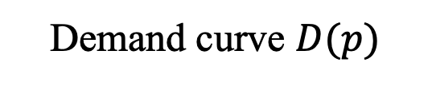






Figure 3. Equilibrium cooperation
(positive externality, with cooperation costs)
$$m=1−δ+\frac{c^{′}\left(m−1\right)}{D^{′}\left(m\right)}$$
Price
Demand curve $D(p)$
Iso-others
Marginal private cost
U
$$1$$
E₃
Consumer indifference
E₂
Marginal social cost
$$m$$
E₁
$$1−δ$$
Consumer indifference
Quantity
0
$$q_{u}=D(1)$$
$$q_{e}=D(m)$$
$$D(1−δ)$$

Slide 16

Figure 3b. Public policy may be overkill
Price
Demand curve $D(p)$
Marginal private cost
U
$$1$$
Marginal social cost
E₁
$$1−δ$$
Quantity
0

Slide 17


Figure 3b. Public policy may be overkill
Price
Demand curve $D(p)$
U
Marginal private cost
U₂=E₁
$$1−s$$
Marginal social cost
E₂
$$1−δ−s$$
Quantity
0

Slide 18
Figure 3c. Public policy may undermine cooperation
Price
Demand curve $D(p)$
Marginal private cost
U
$$1$$
Marginal social cost
E₁
$$1−δ$$
Quantity
0

Slide 19

Four prices in one market
Private marginal cost
  The marginal private cost if NOT cooperating
  Normalized to one
Average price p < 1
  Total expenditure divided by quantity. A.k.a., “net price”
Marginal price m < p < 1
  Equals social marginal cost inclusive of cooperation
Social marginal cost w/o cooperation
  $1−δ<m<p<1$

Slide 20
Figure 3. Equilibrium cooperation
(positive externality, with cooperation costs)
Price
Demand curve $D(p)$
Marginal private cost
Iso-others
U
$$1$$
Consumer indifference
net price
E₂
Marginal social cost
$$m$$
$$1−δ$$
Quantity
0
$$q_{u}=D(1)$$
$$q_{e}=D(m)$$

Slide 21

Prices created by volume discounts
Volume discount implemented with a rebate tied to quantity purchased
  r(q) > 0, with $r^{′}\left(q\right)>0$
  For clarity, here private MC is denoted L rather than one
  $$net price∗q=\left[1−r\left(q\right)\right]Lq$$
$$m=\frac{d}{dq}\left\{\left[1−r\left(q\right)\right]Lq\right\}=\left[1−r\left(q\right)\right]L−r^{′}\left(q\right)Lq$$
$$m<\left[1−r\left(q\right)\right]L<L$$
Exactly as Figure 3 predicts

Slide 22
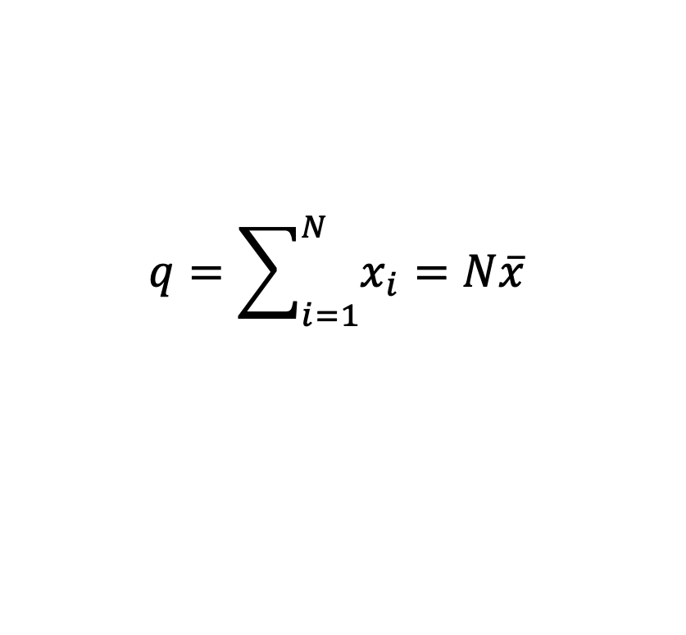
Public Goods
Symmetric special case of positive externalities
  Everyone receives the same externality
E.g., aggregate endowment can be allocated between private and public goods. q is the amount of the public good. x is the individual contribution
i.e., private marginal cost is one (Nash) while social marginal cost is 1/N
$$q=\sum_{i=1}^{N}{x_{i}}=N\overline{x}$$

Slide 23

Figure 4. Voluntary supply of a public good
Price
Demand curve $D(p)$
Marginal private cost
U
$$1$$
Diseconomies of scale?
Marginal social cost
Larger group cooperating
E₁
$$1/N$$
Quantity
0
$$q_{u}=D(1)$$
$$q_{e}=D(m)$$
$$D(1−δ)$$

Slide 24
Public Goods: Supply from Voluntary Associations
Group WTP is the sum of MRS among M < N members only
  E.g., might enforce matching contributions
  May supply nearly the efficient quantity
  Even better if some excludability. Infectious disease!
Group acts like an individual with WTP scaled up, or MC scaled down, by M
  The other N – M unilateral actors may contribute nothing
  i.e., the unilateral actors will free ride

Slide 25
Public Goods: Supply from Voluntary Associations
Group WTP is the sum of MRS among M < N members only
  E.g., might enforce matching contributions
  May supply nearly the efficient quantity
  Even better if some excludability. Infectious disease!
Group acts like an individual with WTP scaled up, or MC scaled down, by M
  The other N – M unilateral actors may contribute nothing
  i.e., the unilateral actors will free ride
“the business enterprise … made possible more elaborate specialization and machinery, more perfect coordination of effort and greater reduction of waste than could be attained by the family.”

Slide 26
Fighting Infectious Disease at Work
60-70 percent of employers offer on-site flu shot
  Among employed persons, the workplace is the most common place to receive it (doctor office close second)
  Hardly any self-employed (= small business?) receive at work
  Self employed much less likely to vax than employees
61 percent of workers have paid sick leave
  50 percent at small businesses (< 50)
  81 percent at large businesses (>499)
The firm-size gradient: scale economies in provision? accumulated MRS (Samuelson)? Disease severity?

Slide 27
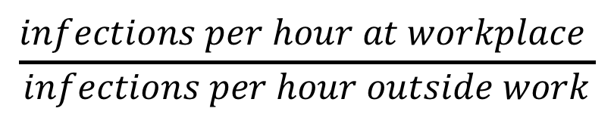
$$\frac{infections per hour at workplace }{infections per hour outside work}$$

Slide 28
Externalities in Centrally-Planned Economies
Central planning/management did not alleviate externalities
  Much pollution
  Hierarchical structure undermines impromptu cooperation
  Lack of a reliable price system makes externalities worse
  Each seller “tends to neglect the requirements of the user, and finds that it is actually beneficial to do so.”
Source: Nove, Alec. “Socialism and the Soviet Experience.” in The Economics of Feasible Socialism Revisited.
“Externalities refers to situations when the effect of production or consumption of goods and services imposes costs or benefits on others which are not reflected in the prices charged for the goods and services being provided.”
  Quote from OECD

Slide 29
Main lessons
Individual action vs state action is a false dichotomy
  An externality is an opportunity for cooperative institutions
The third way can be analyzed with the supply and demand framework
Cooperation has a far different incidence than state action
Policy analysis is, at best, incomplete if it fails to consider voluntary cooperation

